Slide 1
WEB SCRAPPING Taking out data from the website, it helps in taking out the unstructured data from HTML into structured data in our spreadsheet
BY : Oshika Tomar
oshikatomar13@gmail.com
7417400490

Slide 2
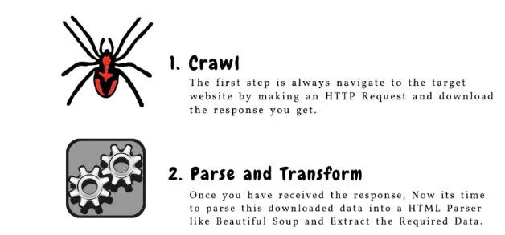
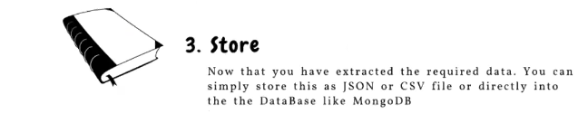
TWO COMPONENT OF WEB SCRAPPING

Slide 3


First install the BEAUTIFULSOUP extention in juyter or vs code, so that BEAUTIFULSOUP library work
Method BEAUTIFULSOUP to extract data from website
Importing request or asking permission from website to extract data
Importing BEAUTIFULSOUP library
Adding website URL from which we are extracting data

Slide 4
Sending an HTTP request to the URL
Checking if the request was successful (by default status code is 200) with FOR LOOP method
Once we had response from the website then we need to parser the HTML content
Here:- parser means extracting data line by line

Slide 5

Extracting information from the page
Here:- extracting the ANCHOR TAG(extracting all the links) ‘a’ stands for ANCHOR TAG.
((((((( ANCHOR TAGS =>
and convert this link into a msg and when ever we clcik on that msg link will get ooen

Slide 6
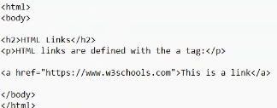


We can also write HTML code is notepad and can also open in browser.
By pressing CTRL+O to open the saved html notepad in browser and then we can click over msg in which link is saved to open the website))))))))))))
Now printing the extracted link
Here:-‘href’ is syntax for mentioning the links from website.
If unable to retrieve the page data print (failed to retrieve the data)

Slide 7
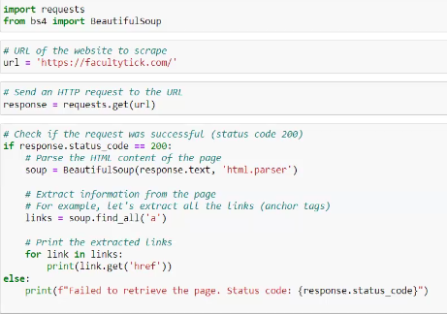
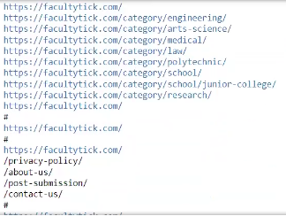
Whole coding will look like this INPUT
OUTPUT

Slide 8
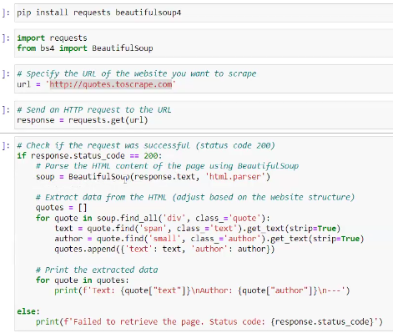
Another example
Here:- we are taking out the quotations along with its author information, ‘span’ and ‘small’Is a tag like anchor tag

Slide 9
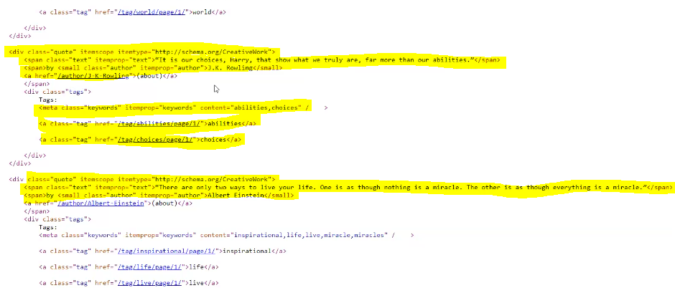
Right click on website and click on ‘inspect’ to have website ‘html’ view

Slide 10
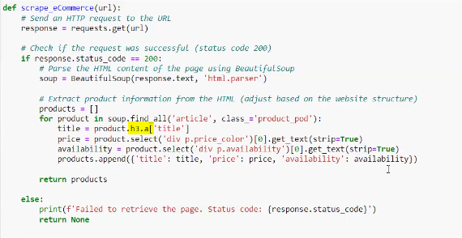
Example3
Extracting product information from HTML
Here:- h3 is heading of title
Passing website URL

Slide 11
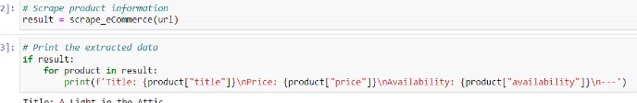
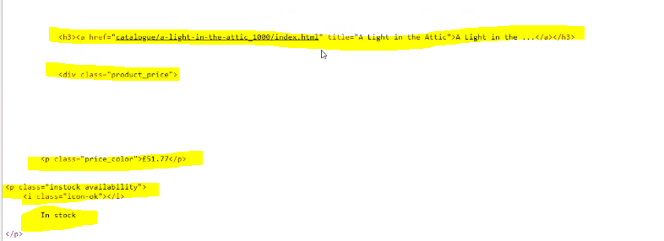
Passing website URL
Scrap project information and print extracted data
Html view

Slide 12
